Slide 1
FLIGHT PRICE PREDICTION PROJECT
Submitted by :
Rupali Bisen

Slide 2
MOTIVATION FOR THE PROBLEM UNDERTAKEN
In this project,we have to make flight price valuation model using new machine learning models from new data. Because with the change in market due to covid 19 impact, our client is facing problems with their previous flight price valuation machine learning models.
It is a very large market and there are various companies working in the domain.
Data science comes as a very important tool to solve problems in the domain to help the companies increase their overall revenue, profits, improving their marketing strategies and focusing on changing trends in car sales and purchases.

Slide 3
ANALYTICAL PROBLEM
FRAMING

Slide 4
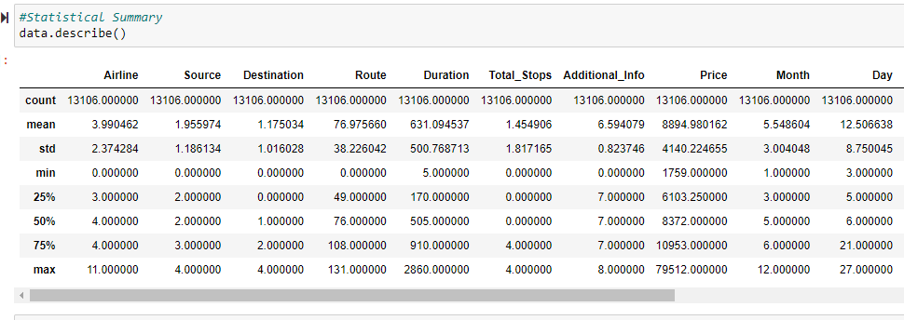
MATHEMATICAL/ ANALYTICAL MODELING OF THE PROBLEM
In this project we have performed various mathematical and statistical analysis such as we checked description or statistical summary of the data using describe, checked correlation using corr and also visualized it using heatmap. Then we have used Z-Score to plot outliers and remove them.

Slide 5
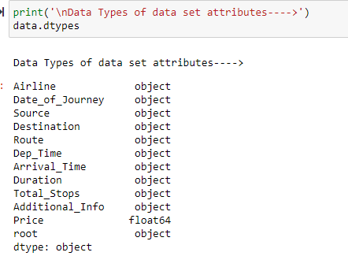
DATA SOURCES AND THEIR FORMATS

Slide 6
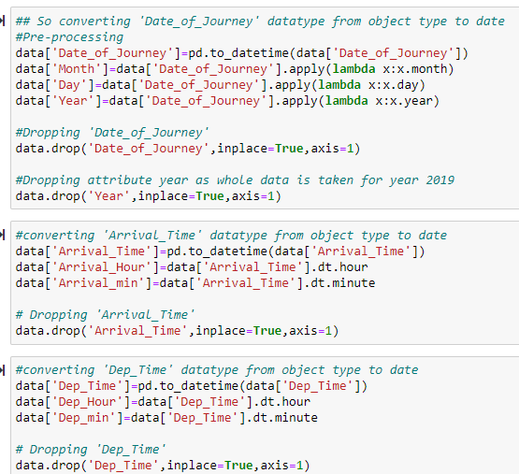
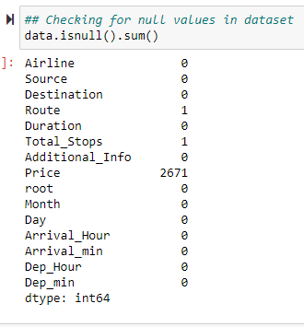
DATA PREPROCESSING

Slide 7
DATA PREPROCESSING
Feature Engineering has been used for cleaning of the data.
Some unused columns have been deleted and even some columns have been bifurcated which was used in the prediction.
We first done data cleaning. We first looked percentage of values missing in columns then we imputed missing values.

Slide 8
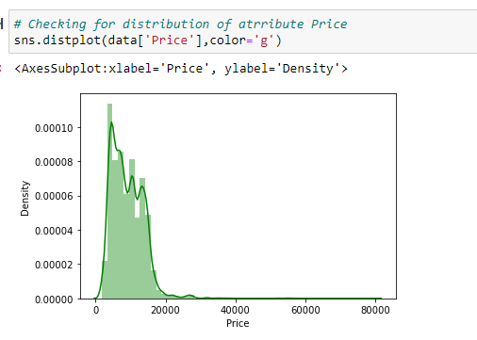

Slide 9
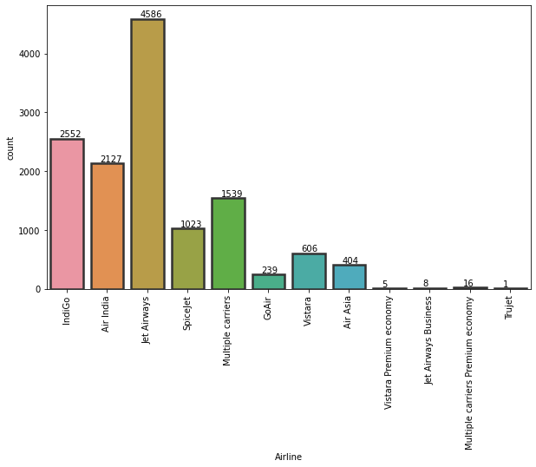
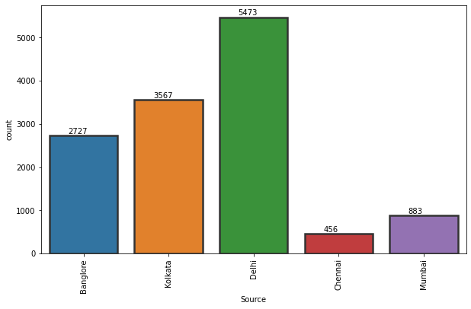

Slide 10
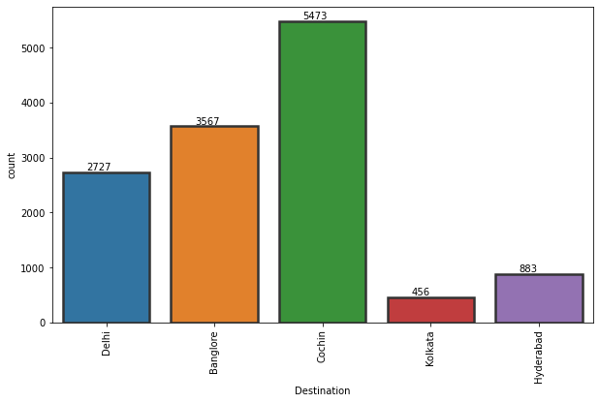
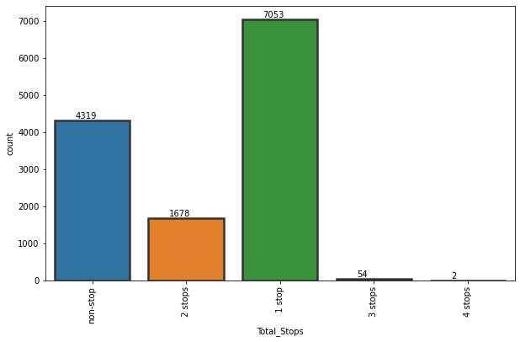

Slide 11
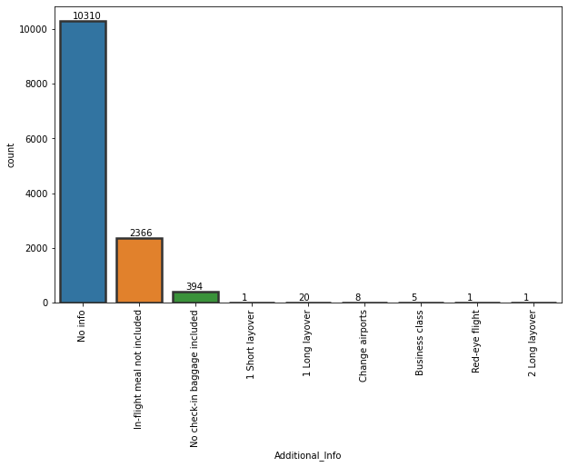
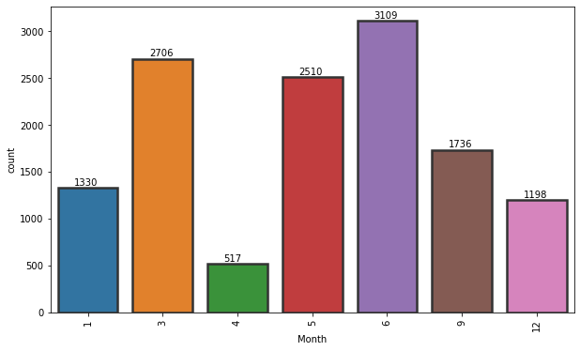

Slide 12
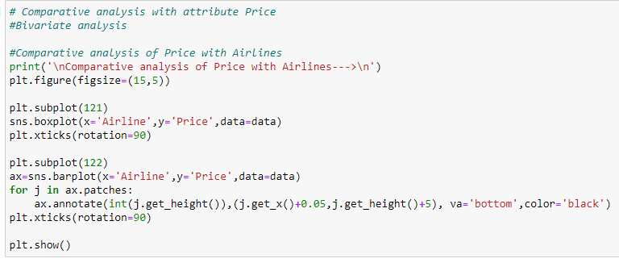
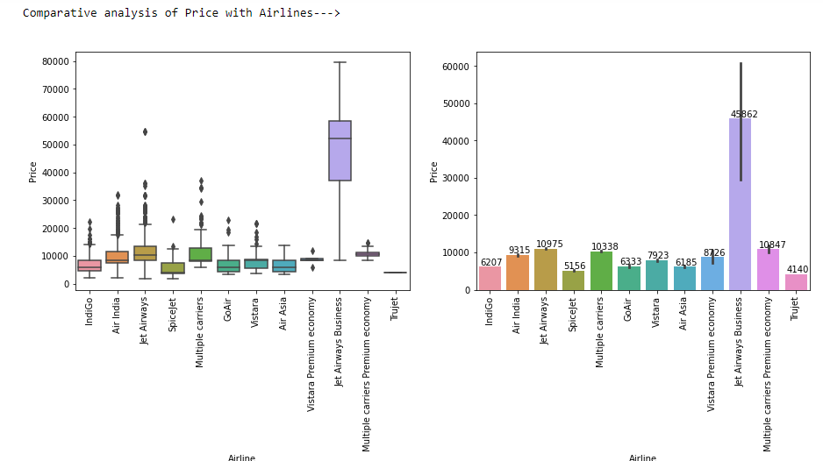

Slide 13
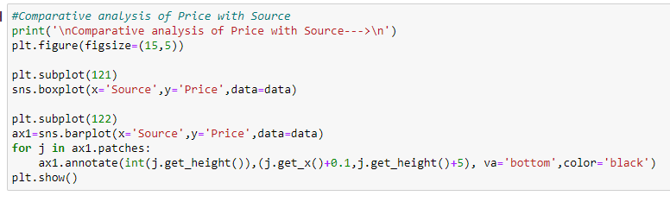
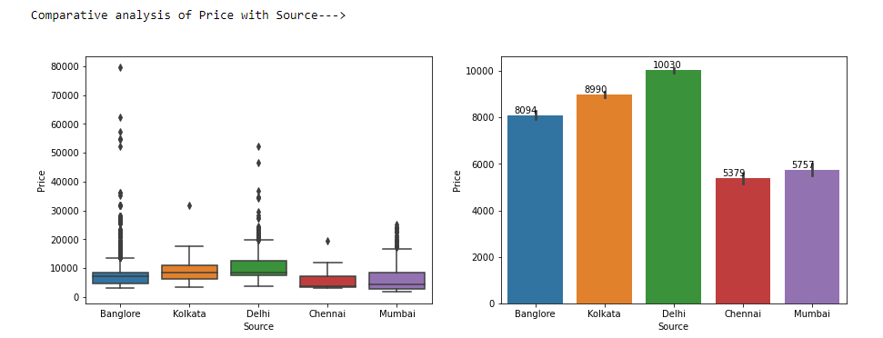

Slide 14
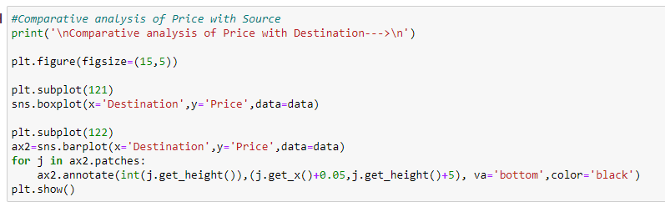
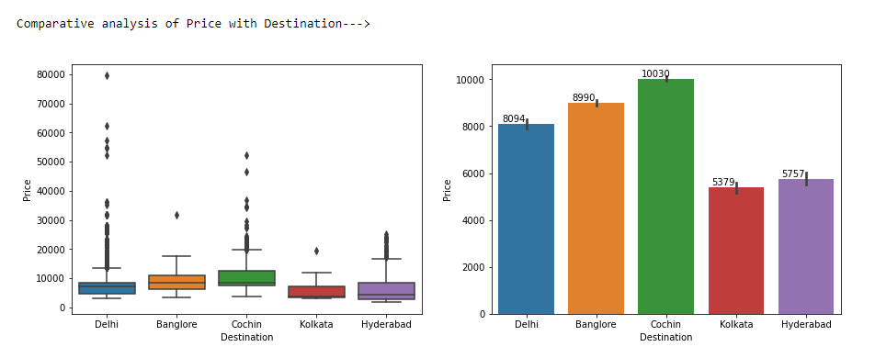

Slide 15
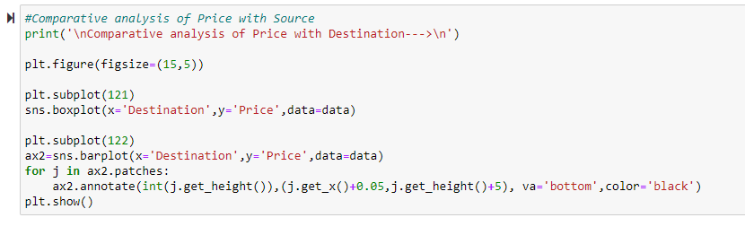
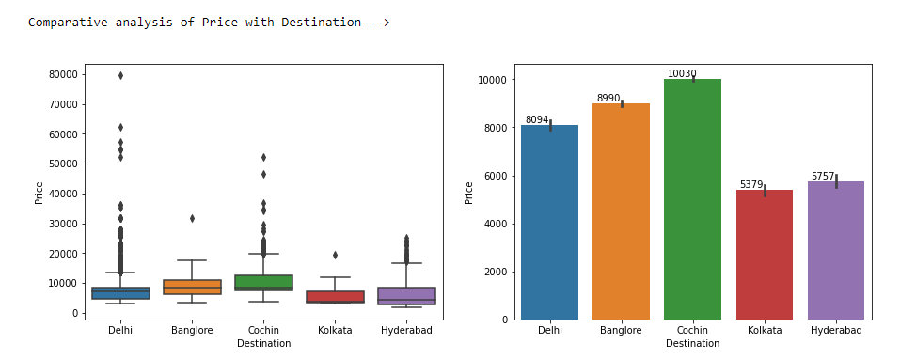

Slide 16
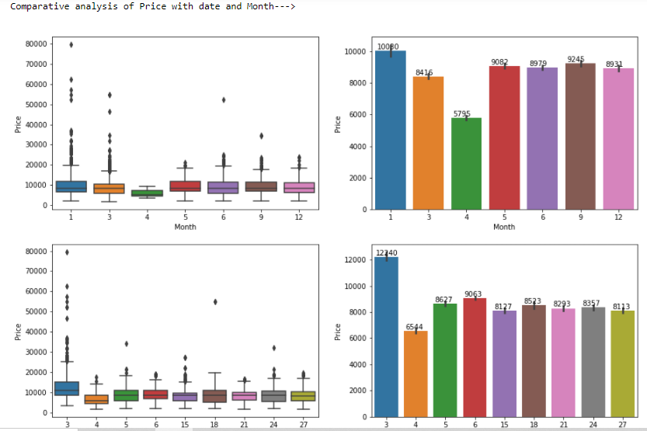
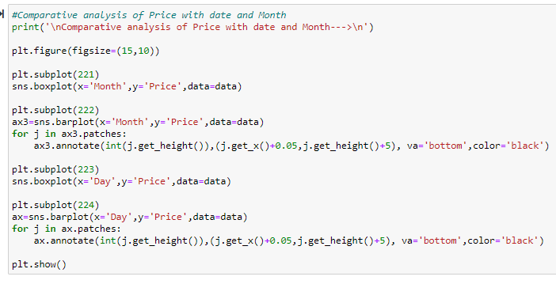

Slide 17
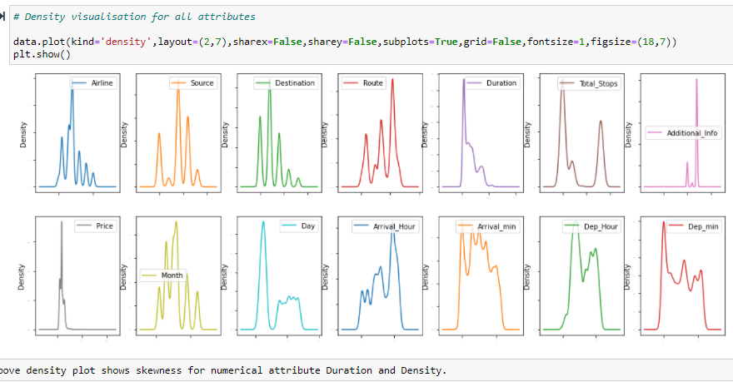

Slide 18
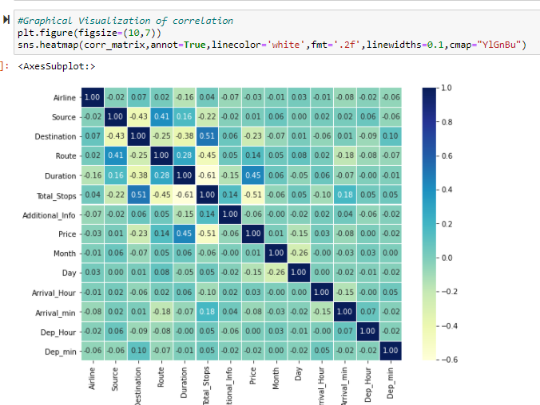

Slide 19
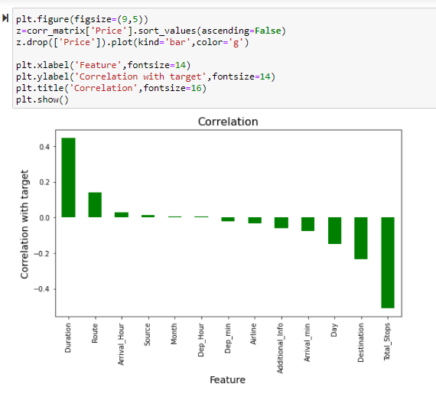

Slide 20
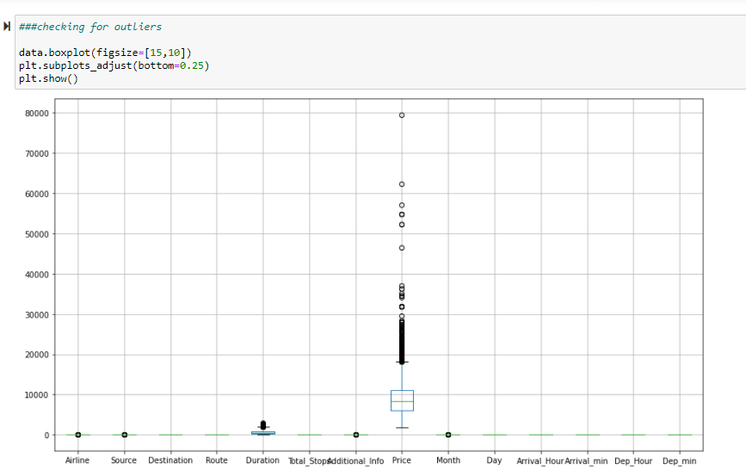
Checking for outliers

Slide 21
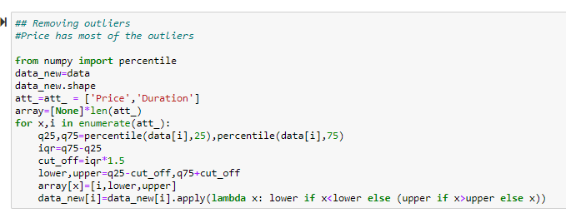
Removing for outliers

Slide 22
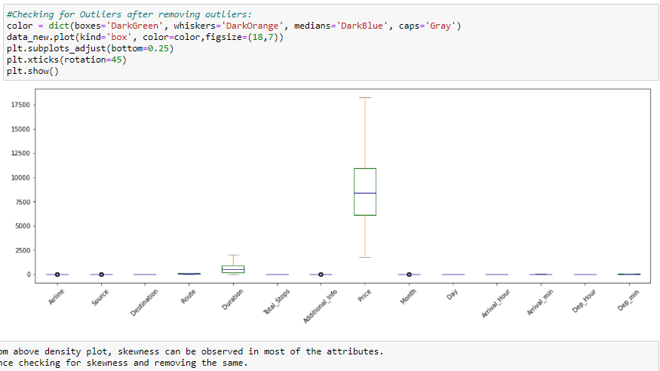

Slide 23
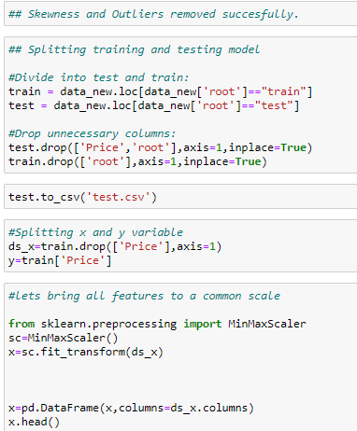
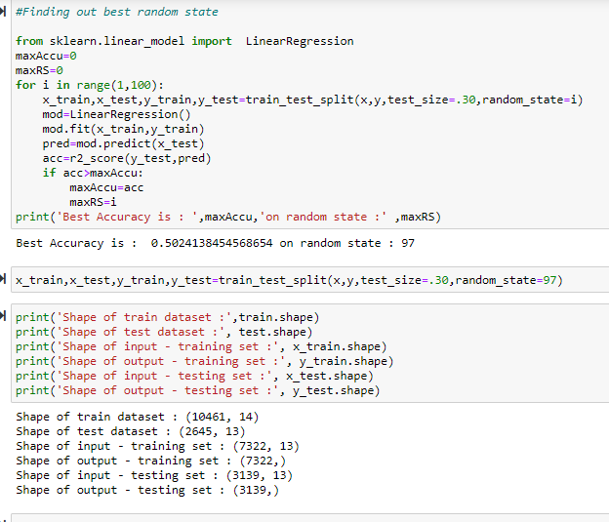
Model Preparation

Slide 24
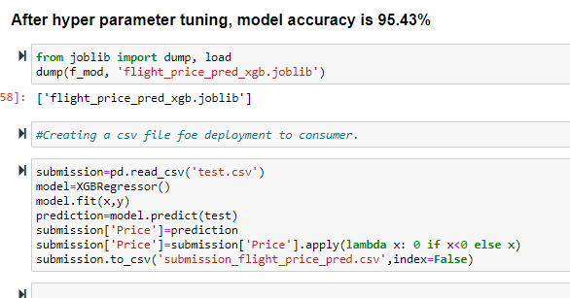

Slide 25
INTERPRETATION OF THE RESULTS
We will develop relevant programming abilities. We will demonstrate proficiency with statistical analysis of data. We will develop the ability to build and assess data-based models. We will execute statistical analysis with professional statistical software. The best algorithm for this project according to my work is LassoRegressor because the accuracy that I have achieved is quite satisfactory than the other model.

